Slide 1
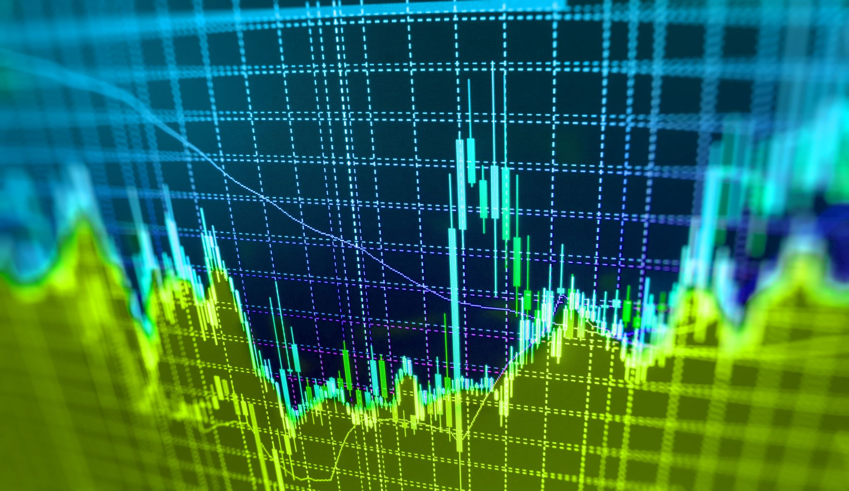
Ibm data science capstone
BATTLE OF THE NEIGHBORHOODS
GUILLERMO DEL CASTILLO

Slide 2
Introduction
Quito is the capital of Ecuador, the country's most populous city, and at an elevation of 2,850 metres (9,350 ft) above sea level, it is the second-highest official capital city in the world.
The historic centre or Old Town of Quito is one of the largest, least altered and best-preserved in the Americas. A monument and museum marking the general location of the equator is known locally as la mitad del mundo (the middle of the world.
Quito tourism numbers exceeded half a million visitors in the first nine months of 2019, 48% of all arrivals in Ecuador, which is 5% more than the number of visitors recorded in the first nine months of the previous year.
For entrepreneurs looking to investing in business like specialty cafes and restaurants would be a great opportunity considering the locals and tourist visitors.

Slide 3

Data
I will be using the Foursquare API to explore the nearby venues for both neighborhoods to find the most accurate place to open the Shop. I looked for venues up to 2km range from the latitude and longitude of neighborhoods

Slide 4

Methodology:
Choosing the main locations
Creating a foursquare developer account
Exploring the nearby venues within a specific radius.
Visualizing the unique venue categories within the area.

Slide 5
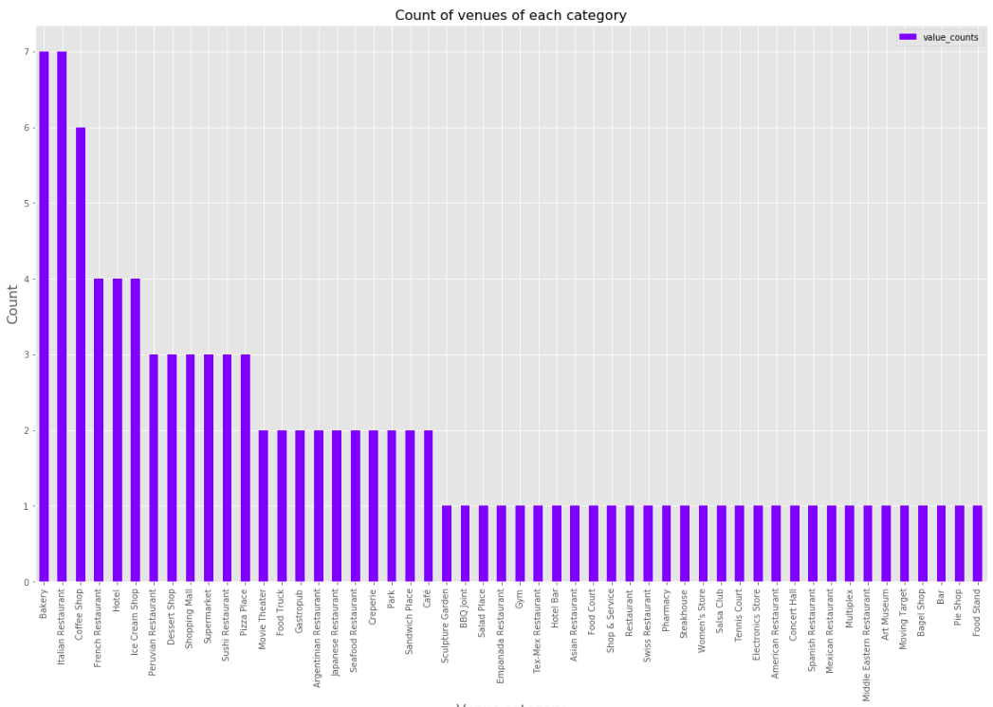
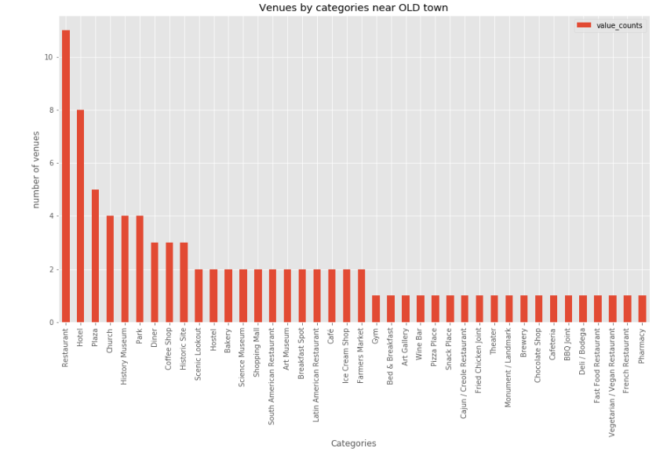
Results:
Quito Downtown
Quito Old Town

Slide 6
As we see above, coffee shop is the highest category for both neighborhoods, and is its number is way higher than other categories. We can see that there are coffee shops category and Café category, but I am going to treat them as one, as they both serve coffee.

Slide 7
Conclusion
We can see that opening a cafe in Quito - Old Town is a better option according to the high number of coffee shops in downtown.
Also, the high presence of hotels, historic sites, museums in the Old Town suggest high numbers of visitors with few coffee shops options, making this a great business opportunity.

Slide 8

RESOURCES
https://en.wikipedia.org/wiki/Quito
https://github.com/gdelcast/Coursera_Capstone
https://github.com/gdelcast/Coursera_Capstone/blob/master/Battle%20of%20the%20neighborhoods/Battle%20of%20the%20neighborhoods-FinalReport.ipynb

Slide 9

THANK YOU
GUILLERMO DEL CASTILLO

